Slide 1
Determining the Best Neighborhood of Pittsburgh
Group 40: Jackie Hagner, John Gordynskiy, and Sidney Babiiha

Slide 2
Metrics
The best civilian development
Civilian Development is a measure of how well a neighborhood supports the daily lives, wellbeing, and experiences of the people who live there. Instead of focusing on things like income or crime, this metric looks at community-facing resources that directly improve quality of life.
Number of Parks
Using a dataset detailing all the parks of Pittsburgh, we compiled the amount of parks each neighborhood has.
Number of Playgrounds
Analyzing data showing all the playgrounds within each neighborhood in Pittsburgh, with the highest number of playgrounds indicating the best neighborhood.
Amount of Unused City Held Property
Analyzing data showing all property owned by the city and pulling out the sections that are either unused or unmaintained.

Slide 3
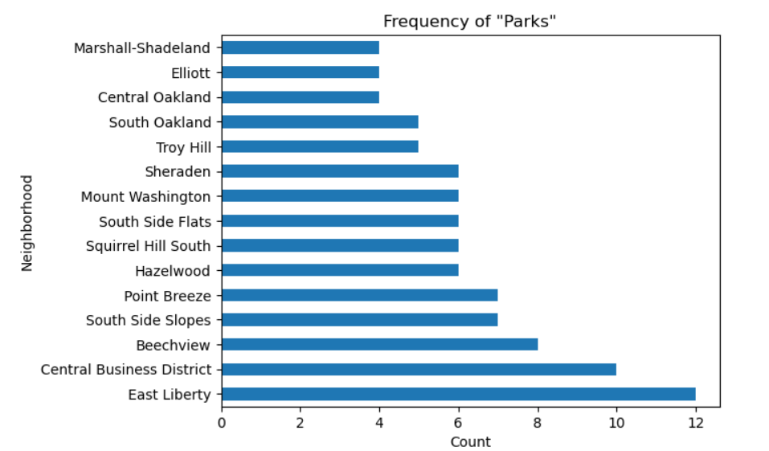
Number of parks
Public parks are important for a city’s well being; if a neighborhood can afford clean, plentiful, and maintained public parks, that’s an excellent indicator of a community that has trust in itself.
The initial dataset included several statistics that weren’t quite parks, such as traffic islands and building grounds, leading to a dataset that wasn’t quite in line with what we were looking for.
Initial bar graph with all “parks”

Slide 4
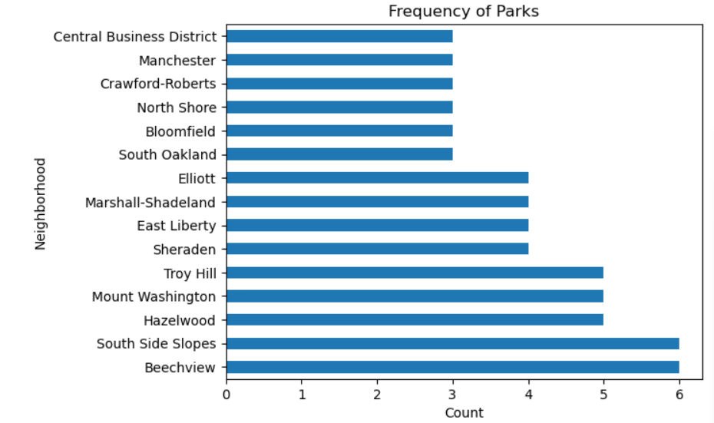
Number of parks
After filtering the dataset to only include parks under the “park” type, we got more usable data.
Beechview (6)
Southside Slopes (6)
Hazelwood (5)
Mount Washington (5)
Troy Hill (5)
Final, accurate bar graph

Slide 5
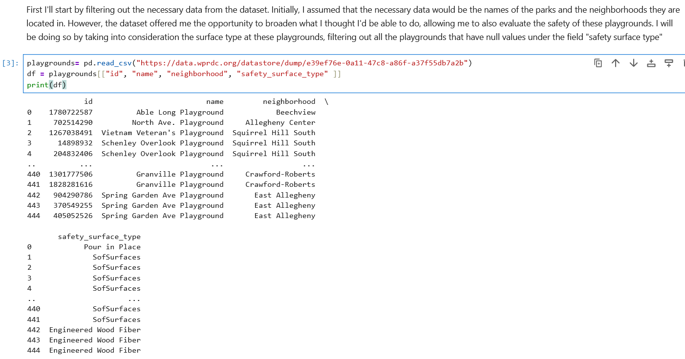
Number of playgrounds
Playgrounds encourage exercise and outdoor time within neighborhoods and the number of playgrounds in a neighborhood can indicate that the city is putting resources into family services, public safety, and recreational spaces in that neighborhood. The dataset therefore allows us to get a realistic picture of how well a neighborhood supports its residents, particularly families, and how strong its civilian development is.
Initially, I assumed that the names of the parks and the neighborhoods they are located in were all I needed. However, the dataset offered me the opportunity to evaluate the safety of these playgrounds as well.
From the dataset, I filtered out the names of the playgrounds, the neighborhoods they’re in and the type of safety surface they have.

Slide 6
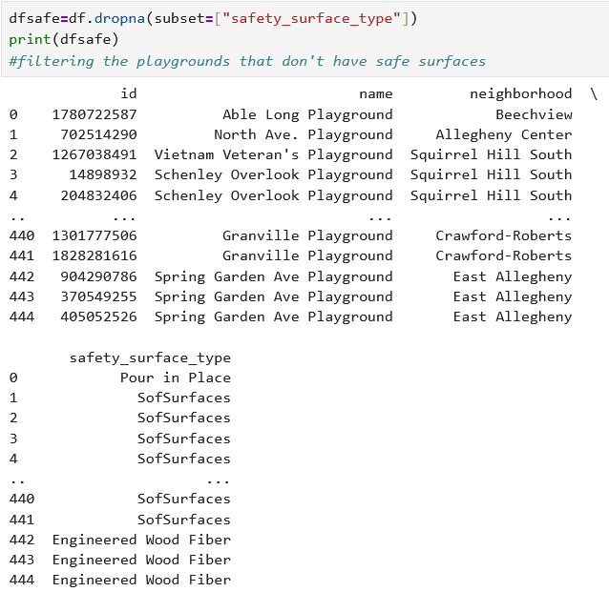
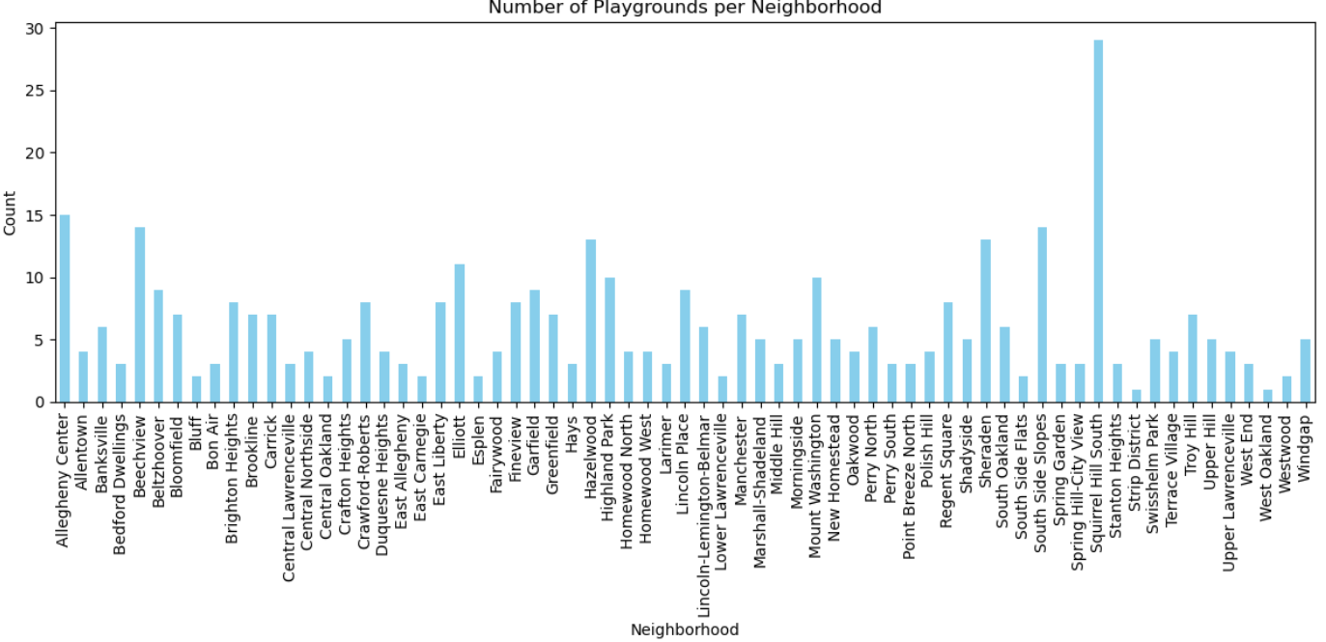
Number of playgrounds
I went on to remove all the playgrounds that didn’t have safety surfaces, making the assumption that the best neighborhood with good civilian development would prioritize the safety of playground users by having safety surfaces.
I then counted how many times each neighborhood with playgrounds with safe surfaces appeared within the dataset and plotted this in a bar graph.

Slide 7
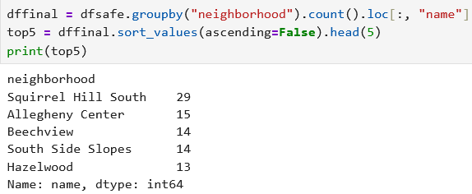
Number of playgrounds
Therefore we can see that the top five neighborhoods with the most playgrounds with safe surfaces are:

Slide 8
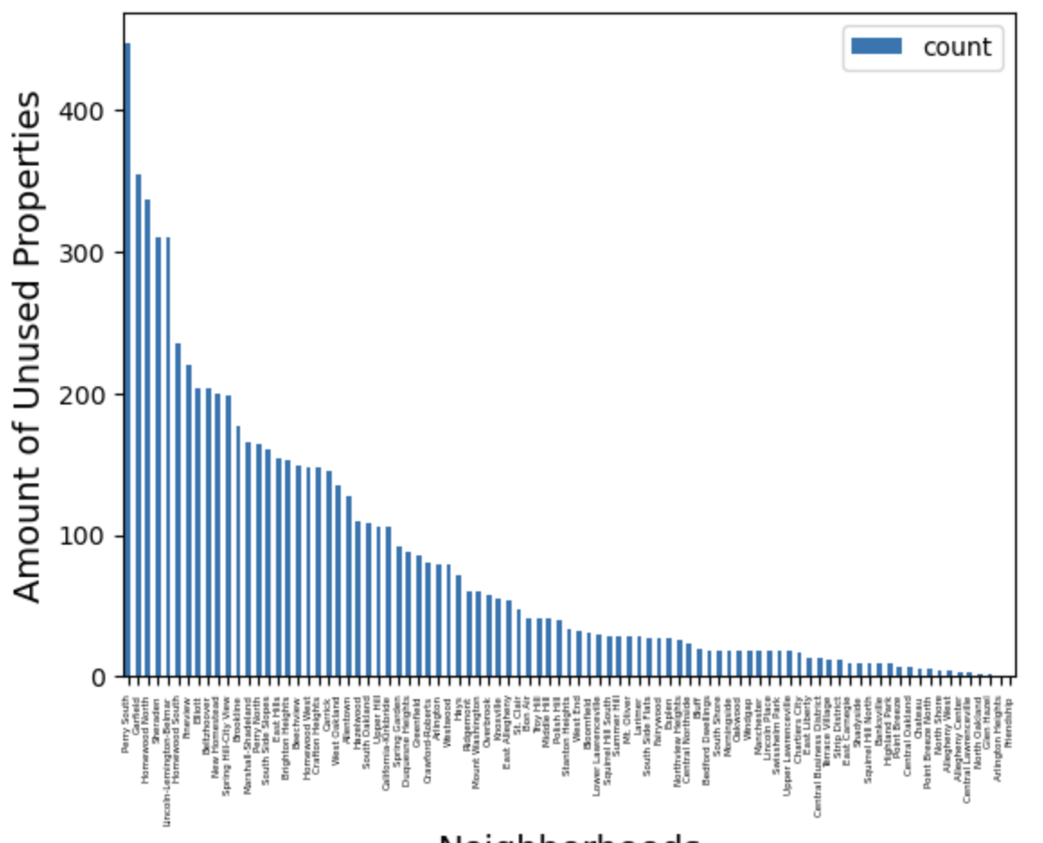
Amount of Unused City Held Property
The following graph shows us each neighborhood’s unused property. Most of them are up for sale, and those that are not are “Held for Study” by the city. A good neighborhood in our opinion will be around the middle of this data set, having enough property for sale that someone has a wider selection of options, but not too much unused property that the neighborhood feels empty. According to this, the best five are Polish Hill, Stanton Heights, West End, Bloomfield, and Lower Lawrenceville. The average number of unused properties is approximately 80 properties.
Therefore, the best neighborhood by this metric is West End.
Polish Hill | 40
Stanton Heights | 33
West End | 32
Bloomfield | 31
Lower Lawrenceville | 30

Slide 9
Conclusion
When we look at the top 5 of the first two metrics, the cities that overlap on the top five lists are: Hazelwood, South Side Slopes, and Beechview. However, these three all line up in the back half of the third category, with the statistics to the left:
Because of the sheer difference in the number of unused properties in Hazelwood, and how much closer it is to the mean of that data set, we can say that Hazelwood is the best neighborhood in Pittsburgh.
Neighborhood | Parks | Playgrounds | Other
Hazelwood | 5 | 13 | 110
South Side Slopes | 6 | 14 | 161
Beechview | 6 | 14 | 149

Slide 10
Thank You!

